Slide 1
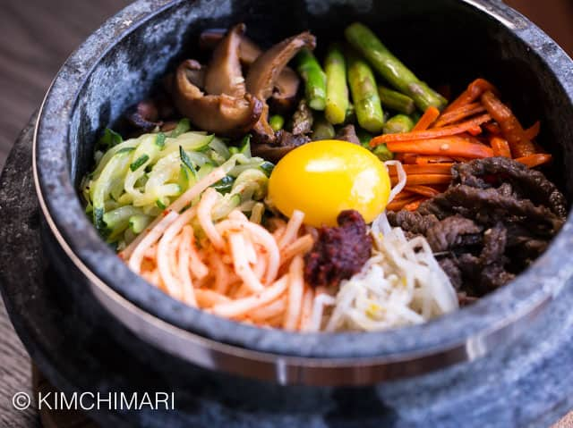
Home
About us
Menu
Gallery
Contact
Ｋorean Food
Various Korean Style food available here !!
Best Cuisine for the most
exquisite taste!!

Slide 2
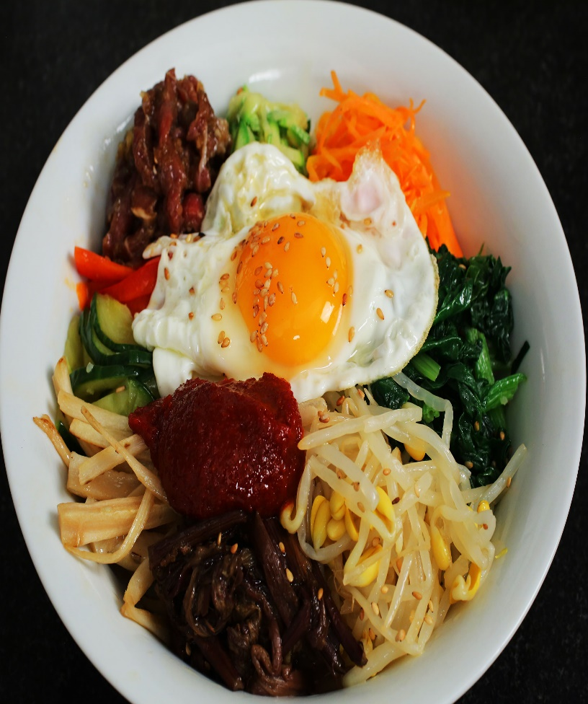
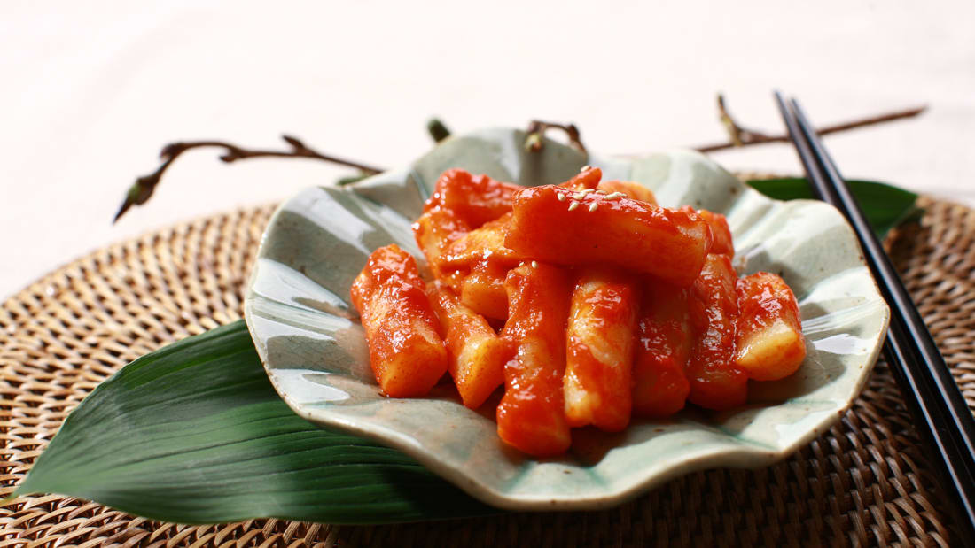
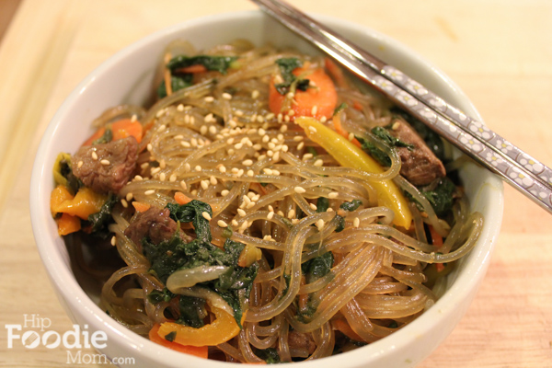
Home
About Us
Menu
Gallery
Contact
1.Bibimbap (mixed rice)
2.Tteokbokki
3.Chapchae(Stir fried noodles)

Slide 3
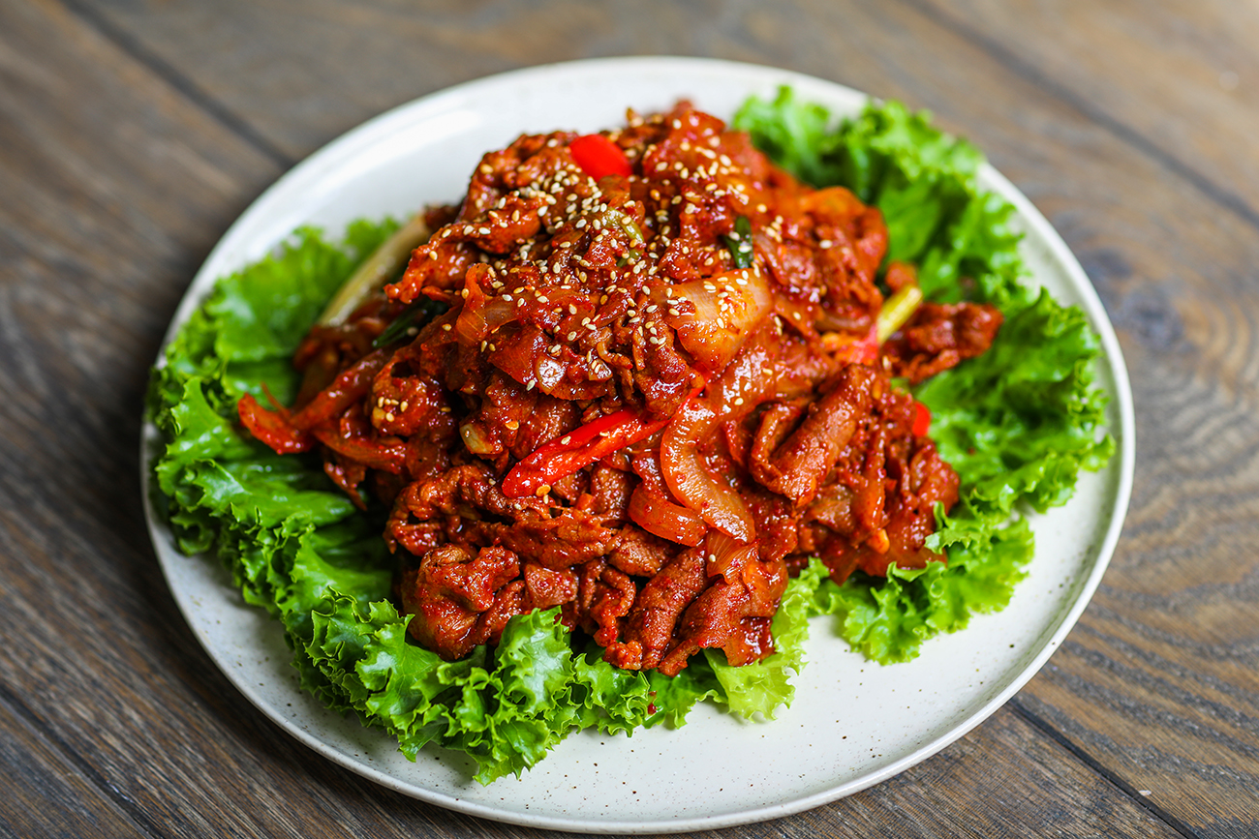
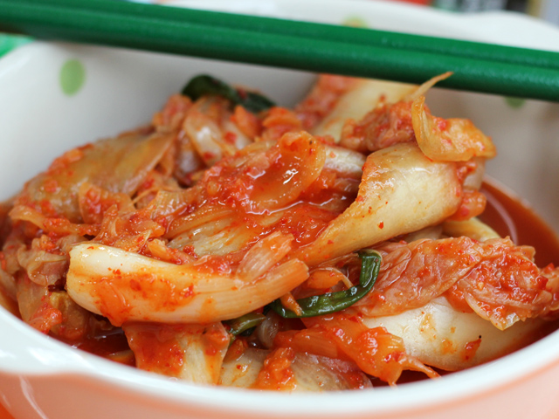
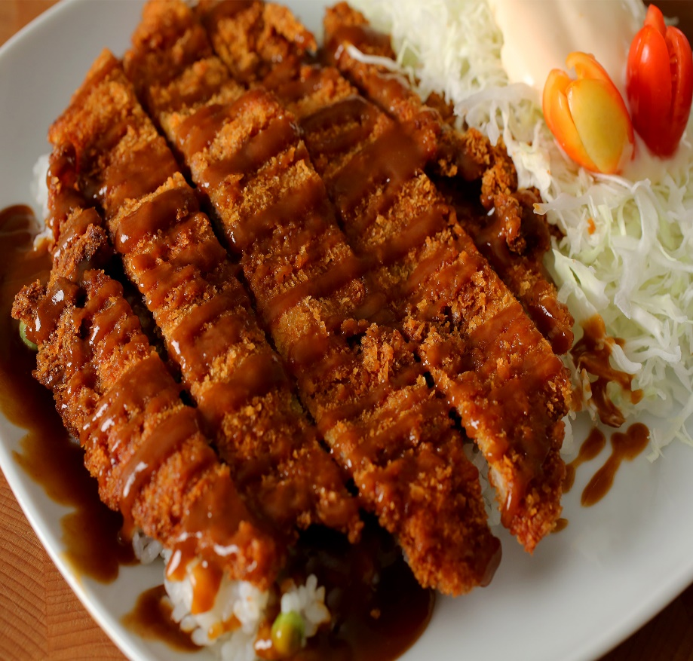
Home
About us
Menu
Gallery
Contact
Home
4. Pork Bulgogi (Daeji Bulgogi )
5. Chili Pickled Cabbage (Kimchi )
6.Donkkaseu(Pork cutlet)

Slide 4
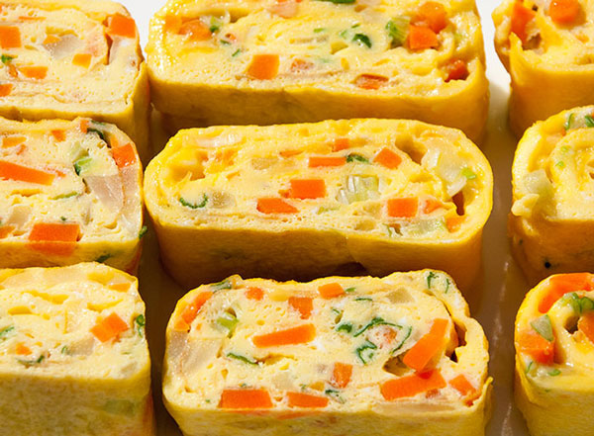
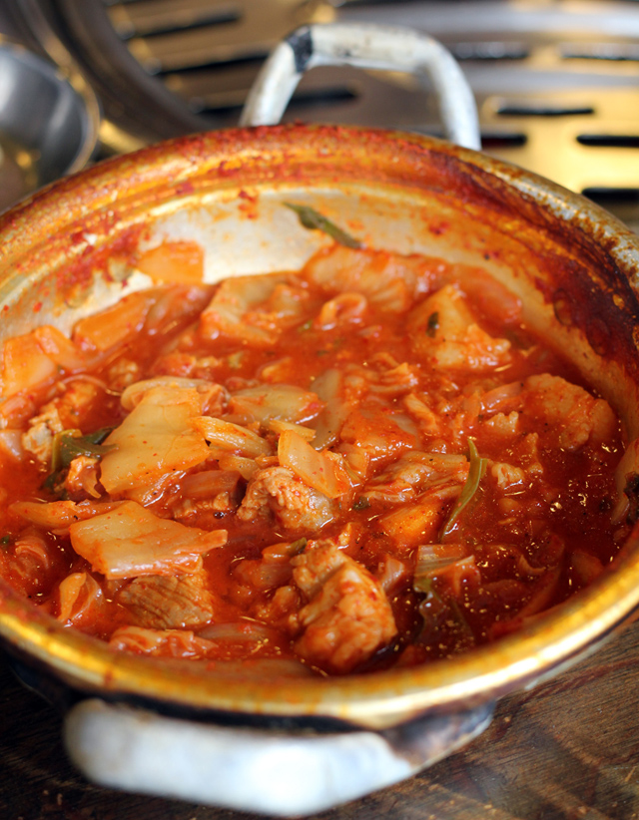
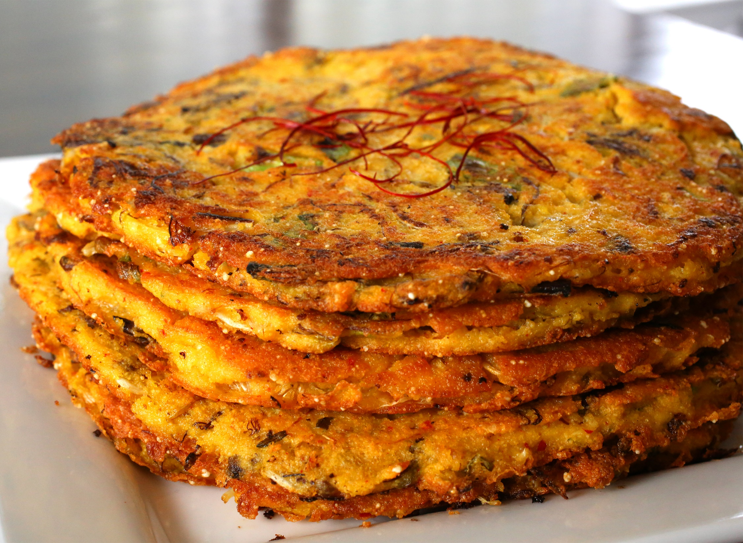
Home
About us
Menu
Gallery
Contact
7. Korean Egg Roll
8. Kimchi Stew
9.Bindaettok(Mung bean paste)

